Slide 1

Social networking site
Submitted to:
Mr. Rajeev Sharma
Assistant professor
Created by:
Gaurav Sharma(1902060)

Slide 2
WHAT IS SOCIAL NETWORKING SITE ?
A social networking service (also social networking site or social media) is an online platform which people use to build social networks or social relationships with other people who share similar personal or career interests, activities, backgrounds or real-life connections.
SOCIAL CONNECTIONS
CREATE
CONTENT.
SHARE
INFORMATION

Slide 3
Methodology / Planning of work and facilities required for proposed work
• Good understanding of languages like HTML5, CSS3 , JAVASCRIPT for frontend development.
• Good understanding of backend technologies like PHP and storing users data in database. Like MySQL.
• Know how to easily use PDO with MySQL databases
• Learn how to develop using an PHP OOP (Object Oriented) approach
• Understand how to use jQuery to retrieve data to display popups, messages, notifications, posts
• Write clean codes
• Learn to rewrite clean URLs like Twitter
• Learn to create MySQL Database Relationships

Slide 4

DEVELOPMENT STACK
LAMP STACK

Slide 5
Technology used
SOCIAL NETWORK
Frontend
Backend
Html 5
CSS/SCSS
JavaScript
php
Database
MySql

Slide 6
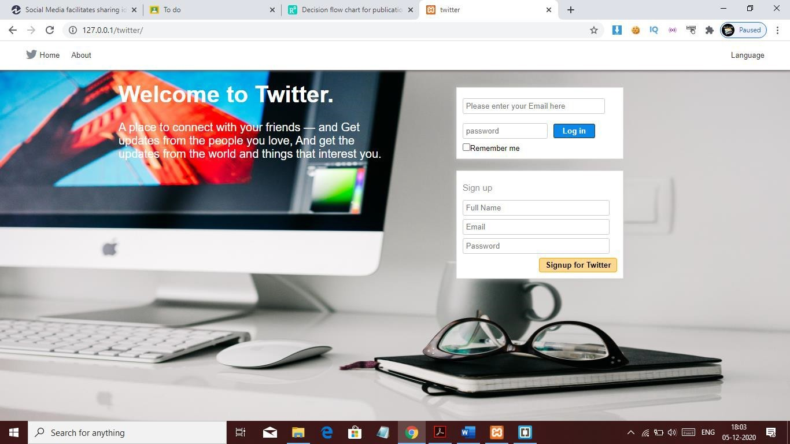
SOME GLIMPSE OF OUR project

Slide 7
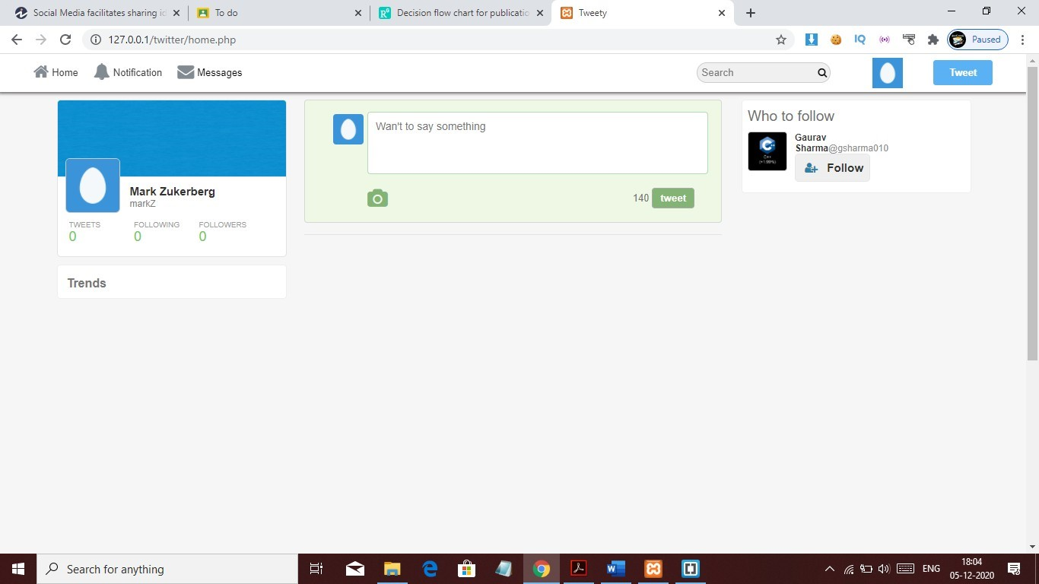
Home page

Slide 8
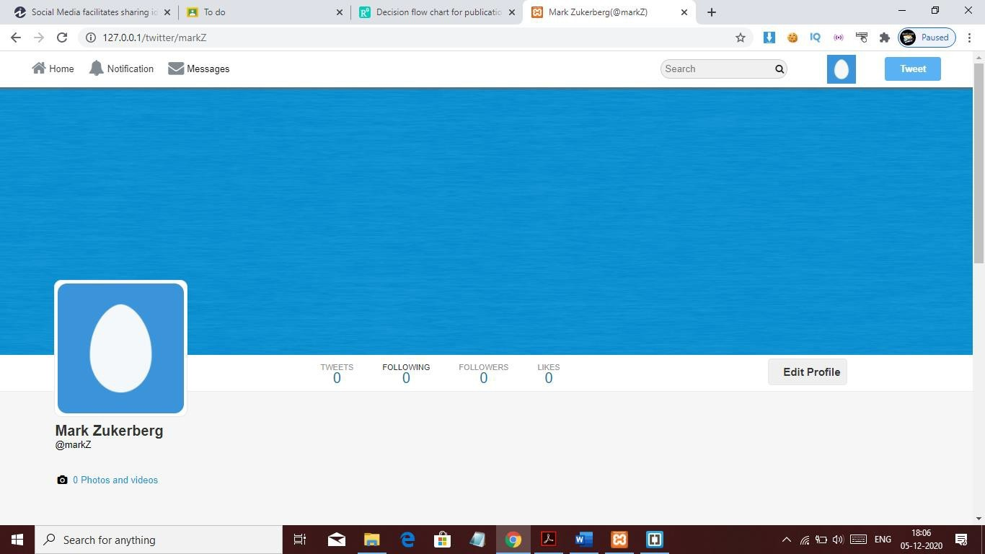
Profile

Slide 9
ACTIONS YOU CAN PERFORM
Login & Sign-up Systems
Users Profiles
Users Timeline
Users Tweets
Users Retweets
Users Comments
News Feeds
Hashtags & Mention Users
Top Trending Posts
Posts & Images Popups
Messages and Chat System
Follow and Unfollow System
Notification System

Slide 10
PROJECT OUTCOMES
USING MULTIPLE WEB TECHONOLOGIES TOGETHER
PRACTICAL USE OF OOP’S (Object- Oriented Programming)
Performing AJAX calls at the backend using jQuery
Writing Clean Code with Proper Architecture
Storing Data inside the Database in different queries
Performing SQL Joins from various tables.
To Know more the source code is available on my GitHub profile @gsharma101

Slide 11
THANKS FOR WATCHING

